Slide 1
Data Center Infrastructure CT109-3-2&Version 2
Room Layout

Slide 2
Topic & Structure of The Lesson
Room Layout

Slide 3
Learning Outcomes
At the end of this topic, YOU should be able to:
Identify IT cabinet types and their installation – including rack mount and blade configurations.
Explain what is a hot aisle/cold aisle configuration and understand the benefits of air management.

Slide 4
Key Terms You Must Be Able To Use
If you have mastered this topic, you should be able to use the following terms correctly in your assignments and exams:
Core Layer
Aggregation Layer
Access Layer

Slide 5
Standard Requirements
Even if small differences between generic and data center cabling are uncovered between the American TIA-942 standard and international and European standards, these bodies of standards essentially differ only in how they name functional elements.

Slide 6
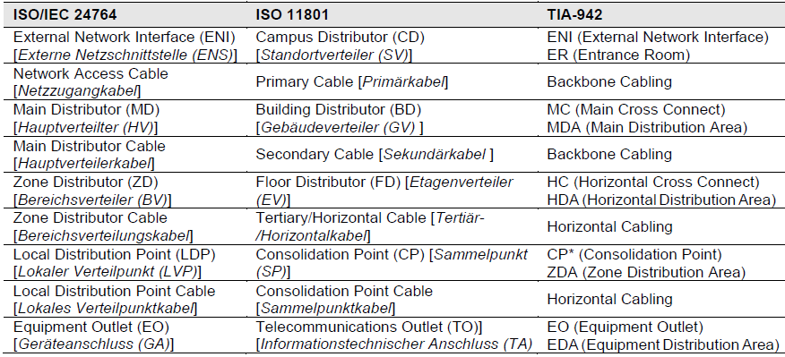

Slide 7
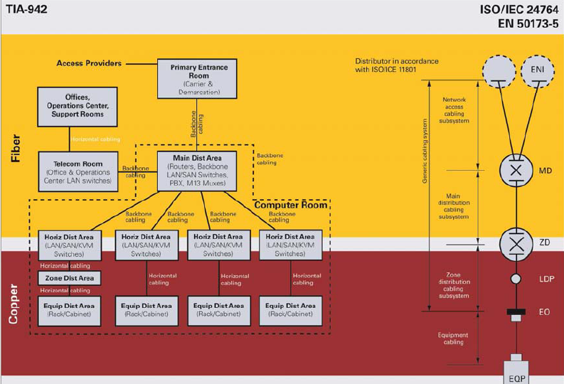

Slide 8
Entrance Room
Entrance Room (External Network Interface): This is the entrance area to the network in the data center, which provides for access to the public network (the Internet provider) and can be connected multiple times, depending upon the “tier” level that is selected. In smaller networks, the External Network Interface can be connected directly to the Horizontal Distribution Area (Zone Distributor).

Slide 9
Main Distribution Area
Main Distribution Area (Main Distributor): This area represents the core of the data center and therefore forms the “lifeblood” of the network, which is why the redundant connections and components just in this area alone are of crucial importance. All data traffic in the backbone is therefore controlled here, which is why this point in the network is known as the Core Layer. However, the Aggregation Layer (or Distribution Layer), whose aggregation/distribution switches bundle and forward Access Layer data traffic to the core, is also located in this area.

Slide 10
Horizontal Distribution Area
Horizontal Distribution Area (Zone Distributor): In this “interface” between backbone and horizontal cabling, the data traffic of the access switches which control the data exchange with terminal devices is “passed over” to the aggregation layer. This area in the network is known as the Access Layer.

Slide 11
Zone Distribution Area (Local Distribution Point): This area is for “interim distribution” to the Equipment Distribution Area, which can be used for reasons of space and is placed in the raised floor, for example. The Raised Floor Solution from R&M that was developed for this purpose provides the ideal option for this process, since it allows up to 288 connections per box and is freely configurable, thanks to its modular design.

Slide 12
Other rooms
Telecom Room: This is the location where the connection to the internal network is located.
The Operation Center, Support Room and Offices are rooms for data center personnel.

Slide 13
Cabling
Backbone cabling is preferably laid with fiber optic cables, and horizontal cabling with copper cables.
Possible transmission protocols and the associated maximum transmission rates are defined at the same time that cable types are selected, which is why this is a significant decision which determines the future viability of the data center.
An equally important factor in data center scalability is determination of the cabling architecture, which in turn influences network availability and determines rack arrangement.

Slide 14
Room Concepts
Different room concepts exist with regard to data center layout

Slide 15
Room-in-Room Concept
The classical Room-in-Room Concept with separate technical and IT security rooms that house any type and number of server racks and network cabinets is equipped with raised floors, dropped ceilings if necessary, active and passive fire protection and a cooling system.

Slide 16
Modular Container Concept
The large room container is a Modular Container Concept with separate units for air conditioning and energy, as well as an IT container to house server, storage and network devices.

Slide 17
Self-Sufficient Outdoor Data Center
The Self-Sufficient Outdoor Data Center, with its own block heating and generating plant, also provides a transportable data center infrastructure, but is independent from the external energy supply. The associated power plant provides for the supply of both energy as well as cold water, through an absorption unit.

Slide 18
Compact Data Center
The redundant, automated Compact Data Center represents an entire, completely redundant data center which includes infrastructure and high-performance servers in one housing. Due to its high power density, this “Mini Data Center” is also a suitable platform for private cloud computing.

Slide 19
Security Zones
Information technology security is a broad term which includes logical data security, physical system security, and organizational process security. The goal of a comprehensive security concept is to examine all areas, detect and assess risks early on and take measures so that a company’s competitive ability on the market is not at risk.
When a company’s IT infrastructure and different IT functional areas are taken into consideration, a well throughout design can reduce or even eliminate significant physical security risks. Both the locations of IT areas and the spatial assignment of different functions together play a decisive role in this process.

Slide 20
Functional Areas
The following criteria should be examined when considering the physical security of a data center location:
· Low potential of danger through neighboring uses, adjacent areas or functions
· Avoidance of risks through media and supply lines, tremors, chemicals, etc. which may impair the physical
security of IT systems
· Prevention of possible dangers through natural hazards (water, storms, lightning, earthquakes) – assessment
of the characteristics of a region
· The data center as a separate, independent functional area
· Protection from sabotage via a “protected” location
· An assessment of the danger potential that is based on the social position of the company

Slide 21
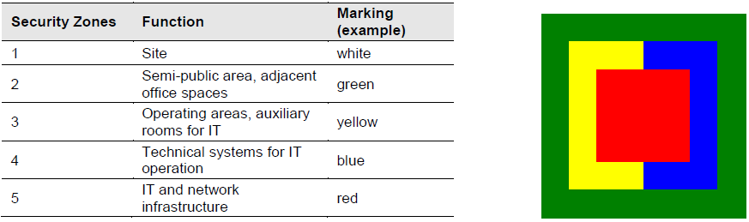
The different functional areas can be divided up as follows:

Slide 22
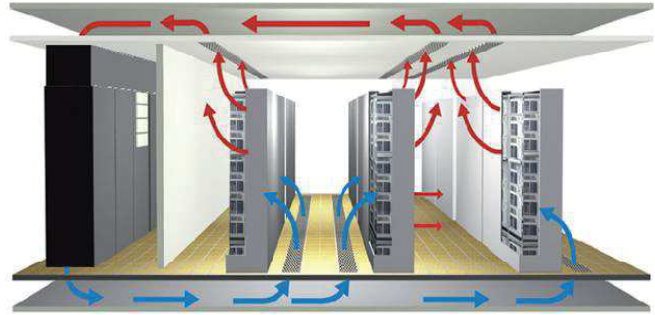
Solution per the cold aisle/hot aisle principle – closed-circuit air conditioning

Slide 23
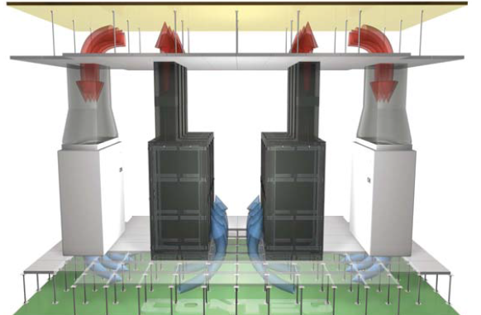
Plenum Feed, Plenum Return

Slide 24
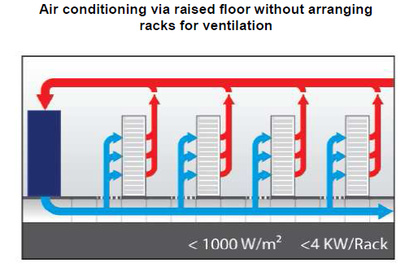

Slide 25
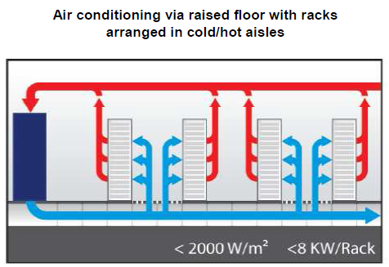

Slide 26
Quick Review Question
Briefly explain the following:
Core Layer
Aggregation Layer
Access Layer

Slide 27
Summary of Main Teaching Points
Discussed room layout in detail

Slide 28
Question and Answer Session
Q & A

Slide 29
What we will cover next
Fire Protection and Security Systems

